Slide 1
Composite Pattern

Slide 2
Related Issues
How to represent state diagram where a state may contain other states?
How to traverse different aggregate structure, and how to apply the algorithm to the objects of the complex class structure?
16-<number>

Slide 3
What is Composite Design Pattern?
Compose objects into tree structures to represent part-whole hierarchies.
Components can be further subdivided into small components.
Composite lets clients treat individual objects and compositions of objects uniformly.
16-<number>

Slide 4
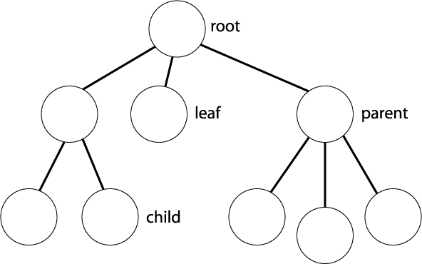
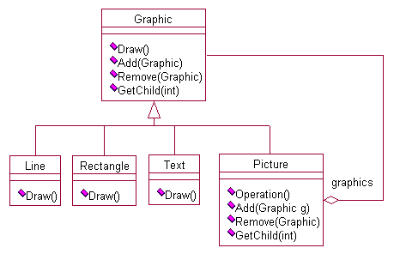
Composite Diagram
Tree Structure
Whole-Part Structure
16-<number>

Slide 5


When to use?
When you want to dealing with Tree-structured data.
When you want Clients to be able to ignore the difference between compositions of objects and individual objects.
Abstract Class(Interface)
?
Composite object
?
Leaf object

Slide 6
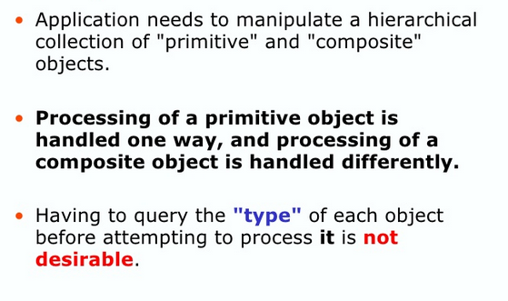
Problem handling primitive and components
16-<number>

Slide 7

Component→Leaf, Composite
Composite contains Component(leaf, composite)
1
Component
(composite)
2
Component
(composite)
Composite
3
Component
(Leaf/Primitive)

Slide 8

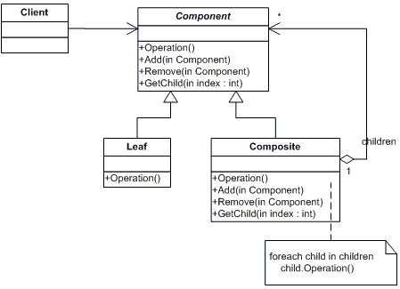


Composite Structure

Slide 9
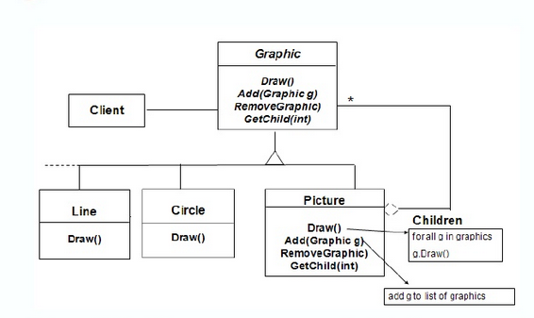
16-<number>

Slide 10
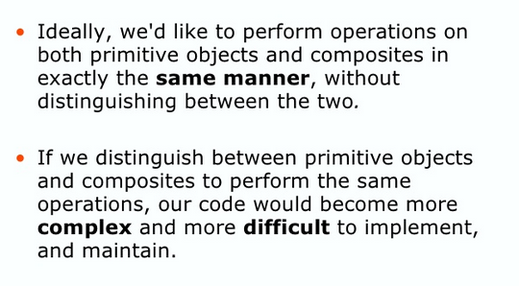
Why Composite Design Pattern?
16-<number>

Slide 11
Composite Pattern
Component
add(c: Component)
remove(c: Component)
get (...): Component
operation()
It provides default implementation for the composite-only operations.
Client
*
child
It overrides the component operations
Primitive Component 1
operation()
Primitive Component 2
operation()
Composite Component
add(c: Component)
remove(c: Component)
get (...): Component
operation()
for each child
child.operation();
16-<number>

Slide 12
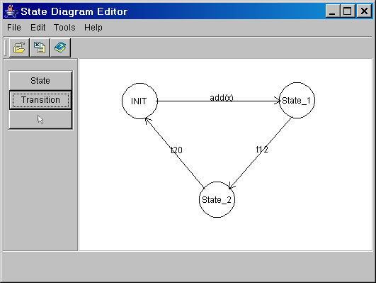
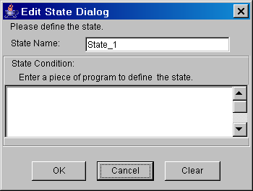
Case Study: Design a State Diagram Editor
16-<number>

Slide 13
Representing Recursive Whole-Part Structures
A state diagram consists of states and transitions, a state may be a composite concurrent state or a composite sequential state, which is a state diagram.
Design problem: how does one represent complex, recursive whole-part structures?
16-<number>

Slide 14
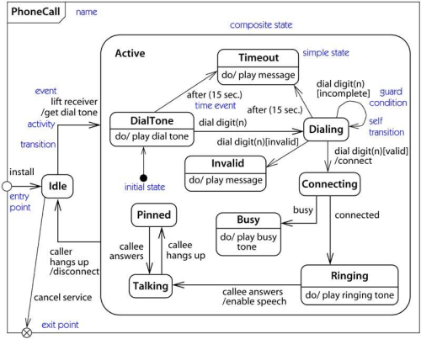
Nested State Diagram
16-<number>

Slide 15
Applying Composite Pattern
Diagram Element
name: String
loc: Point
draw(g: Graphics)
intersect(p: Point): boolean
add(e:DiagramElement)
get (...): DiagramElement
remove (e: DiagramElement)
...
Edit State Diagram Controller
g.drawString(name, ...);
for each c in components
c.draw(g);
*
components
State
width: int
height: int
draw(g: Graphics)
intersect(p: Point): boolean
source
Transition
dest: Point
draw(g: Graphics)
intersect(p: Point): boolean
State Diagram
path: String
draw(g: Graphics)
intersect(p: Point)
boolean
add(e:DiagramElement)
get (...): DiagramElement
remove(e: DiagramElement)
...
*
*
destination
draw state
draw transition
16-<number>

Slide 16
Transparency
Safety
+printStruct()
+add_child()
+Remove_child()
Component
+printStruct()
Component
+printStruct()
+add_child()
+Remove_child()
Leaf
+printStruct()
+add_child()
+Remove_child()
Composite
+printStruct()
Leaf
+printStruct()
+add_child()
+Remove_child()
Composite

Slide 17
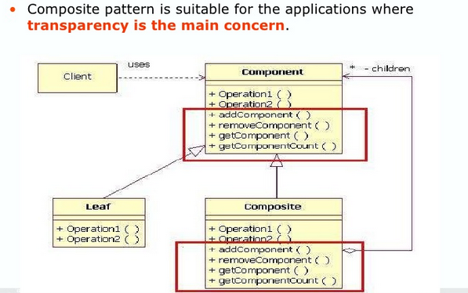
16-<number>

Slide 18
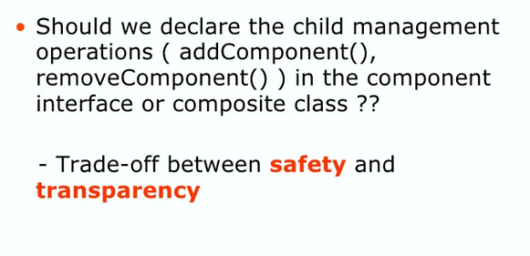
16-<number>

Slide 19
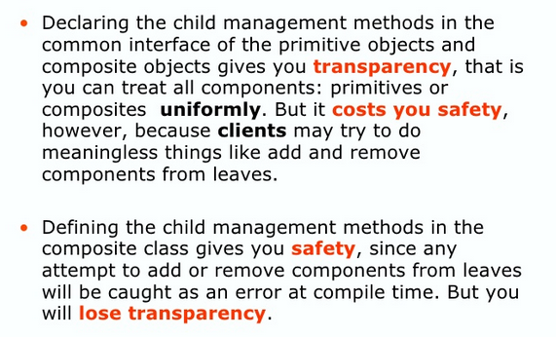
16-<number>

Slide 20
Composite Pattern
The composite pattern describes recursive, whole-part relationships.
It can be used to represent complex class structures.
It lets the client treat the primitive components and composite components uniformly.
16-<number>

Slide 21
Composite Pattern
Benefits
  It makes the client simple
    the client can treat composite objects and primitive objects uniformly.
    the client does not know if it is dealing with a composite or primitive object.
  It is easy to add new kinds of composite or primitive component.
Liabilities
  The client needs to ensure that integrity constraints are satisfied.
16-<number>

Slide 22
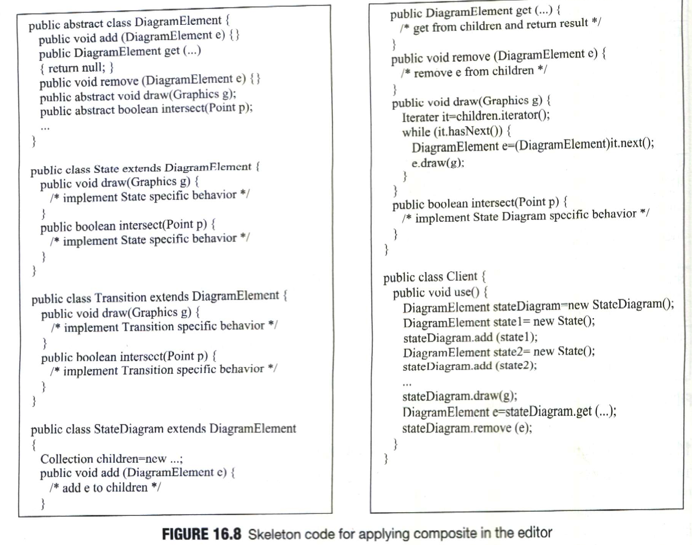
16-<number>

